Slide 1
Chapter 1 Objectives
The CCNA Topics Covered in this chapter include:
  Internetworking Basics
  What is a network?
  Various Networking devices

Slide 2
What is a Network?
A computer network is nothing more than two or more computers connected together in order to share information.
Networking Devices
Equipment that connects directly to a network segment is referred to as a device.
These devices are broken up into two classifications.
End-user devices
Network devices
End-user devices include computers, printers, scanners, and other devices that provide services directly to the user.
Network devices include all the devices that connect the end-user devices together to allow them to communicate.

Slide 3
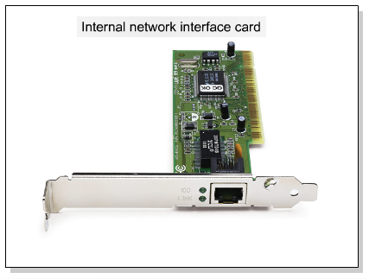
Network Interface Card
A network interface card (NIC) is a printed circuit board that provides network communication capabilities to and from a personal computer. Also called a LAN adapter.
Receive data and convert it into electrical signals
Receive electrical signals and convert them into data
Determine if the data received is for a particular computer
Control the flow of data through the cable

Slide 4
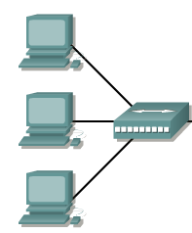
Hub
Connects a group of Hosts
A hub doesn’t manipulator view the traffic that crosses that bus; it is used only to extend e the physical media by repeating the signal it receives in one port out all the other ports

Slide 5
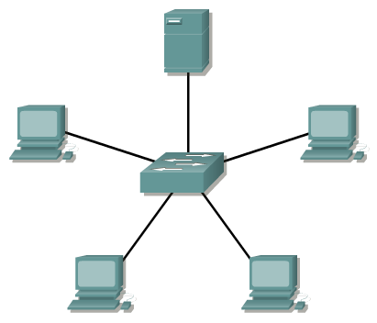
Switch
Switches add more intelligence to data transfer management.

Slide 6

Router
Routers are used to connect networks together
Route packets of data from one network to another

